Slide 1
Why run:ai?
November | 2022

Slide 2
Utilization vs Allocation

Slide 3



Utilization vs Allocation
People sometimes confuse utilization for allocation, but they are not the same.
Allocation refers to the assignment of a certain resource (GPUs, in our case) for use.
Utilization refers to the use of a certain resource (GPUs, in our case) while in allocated.
Data Scientist
GPU 1
usage
GPU-1
Time
GPU-1
GPU 2
usage
GPU-2
Time GPU is assigned for use
Time
A GPU can be allocated…
…but not utilized
Notes:
MLOps pipeline

Slide 4
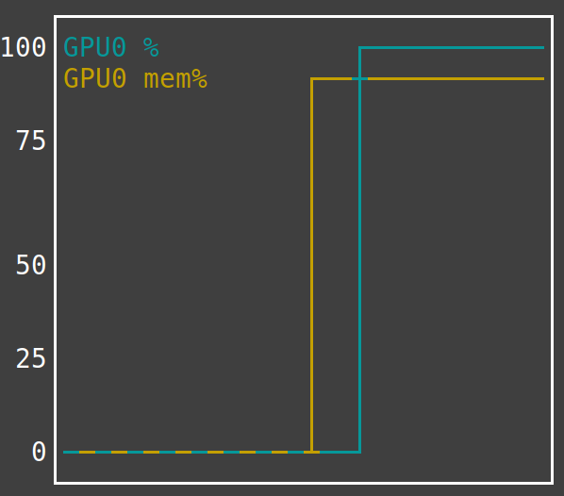
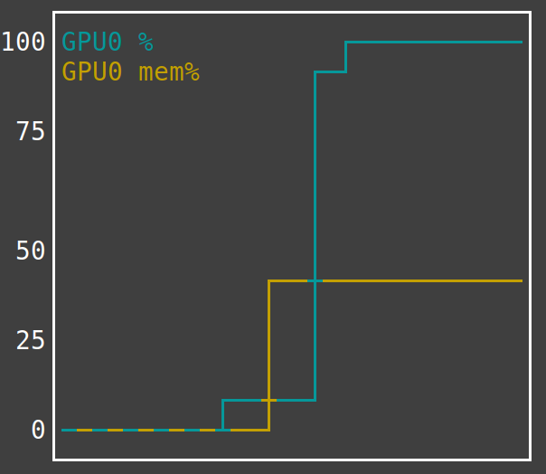
Example of Utilization vs Allocation, with TensorFlow
By default, TensorFlow allocates all GPU memory to itself, regardless of how much it needs.
Only by setting the TF_FORCE_GPU_ALLOW_GROWTH variable to true, will TensorFlow only allocate needed GPU memory.
(default)
export TF_FORCE_GPU_ALLOW_GROWTH=true
One might think they are fully utilizing their GPU memory….
…when in fact, they are not.
Notes:
MLOps pipeline

Slide 5
Ideal GPU Utilization

Slide 6
In a perfect world…
GPU Utilization over time
GPU 1
We would fully utilize all GPUs, at all times.
GPU 2
GPU 3
GPU 4
Therefore, our metric of interest is: Average GPU utilization over time
Avg
Time
Notes:
MLOps pipeline

Slide 7
Sub-optimal GPU Utilization

Slide 8
In real life…
GPUs are ridiculously underutilized! Avg Util Over Time is almost always less than 10%! Why?
Notes:
MLOps pipeline

Slide 9
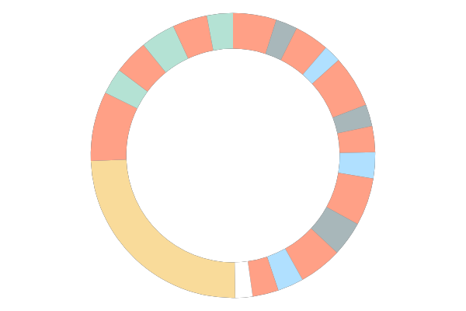
Example: GPU usage during ‘analysis’
During Analysis,
most time is spent writing code.
Intermittently run segments of code to test.
dataset collection
analysis
ETL
train
inference
12
GPU 1
GPU POWERED WORKFLOW
9
3
Time
During analysis, most of my time I am not utilizing the GPU to its fullest capacity.
6
developer.nvidia.com/blog/gpu-accelerated-analytics-rapids/

Slide 10
In real life…
GPUs are ridiculously underutilized! Avg Util Over Time is almost always less than 10%! Why?
During initial analysis/prototyping, most time is spent writing and developing code/scripts. The only time the GPU is used is during sporadic testing of code.
Sometimes the model(s) we are training is very small (or very simple), or the ETL pipeline we are running is not complex.
We might sometimes need to train a series of large/complex models, or complex ETL pipelines, but we don’t run them back-to-back because we get busy (or some other reason).
GPU Utilization over time
GPU Utilization over time
GPU Utilization over time
GPU 1
GPU 1
GPU 1
GPU 2
GPU 2
GPU 2
GPU 3
GPU 3
GPU 3
GPU 4
GPU 4
GPU 4
Avg
Avg
Avg
Time
Time
Time
This is where we see the absolute lowest Average Utilization.
In these cases, we get more consistent utilization, but still do not saturate our GPUs.
Here, there are long periods between high saturation periods where our GPUs do nothing.
Notes:
MLOps pipeline

Slide 11
Optimizing GPU Utilization with run:ai

Slide 12
Goal: Maximize average GPU utilization over time
run:ai is Kubernetes based software specifically designed to maximize GPU utilization
Avg
Avg
Avg
Time
Avg
Time
How?
Fractional GPUs
Dynamic scheduler

Slide 13










Addressing ‘analysis’ low GPU usage
With run.ai fractional GPU
Traditional
Each data scientist can be allocated a fraction of a GPU
Prevents GPU compute power from being taken up by low usage tasks
Frees up GPU resources for other tasks that use them heavily
Each data scientist must be allocated an entire GPU
Because most of a data scientist’s day does not consist of training inference or ETL, GPU usage tends to be low and Most GPU compute power sits idle most of the time
Less GPU resources are available for other tasks that use them heavily
GPU 1
GPU 2
GPU 1
GPU 3
GPU 4
GPU 2
GPU 3
GPU 4
GPU 5
GPU 5
GPU 1
GPU 1
Usage
Allocation
Time
Time

Slide 14
Addressing low GPU saturation
With run:ai factional GPU
Without Run:ai, an entire GPU had to be dedicated to each job.
With Run:ai, a fraction of a GPU (50% in this case) could be dedicated to each job, and all jobs would finish sooner
GPU 1
Time
Time
Time
We can also address the low-GPU-saturation problem with fractional GPUs.
Workloads that do not saturate the GPU can be combined, and run on the same GPU, simultaneously
GPU 1
Time
GPU 1
GPU 1
Entire GPU
Training Job
GPU Usage

Slide 15
Addressing idle GPU time
With run:ai dynamic scheduler
GPU 1
We can address the idle GPU problem with the Dynamic Scheduler.

Slide 16
Dynamic scheduler example:
A
1
B
C
A guaranteed-quota of 2 GPUs per project, is set up
Notes:
MLOps pipeline

Slide 17









What is “guaranteed-quota?”
Ensures a project always has a minimum level of GPU resources available to them.
Project teams
GPUs
Guaranteed-quota GPUs are dynamic, not static. i.e. any GPU from the GPU pool could be allocated to anyone.
Guaranteed quota of 4 GPUs per project
Notes:
MLOps pipeline

Slide 18
Dynamic scheduler example:
A
1
B
C
A guaranteed-quota of 2 GPUs per project, is set up
1
1
After Patty’s job finish running…
When Patty decides to submits some jobs…
2
2
If Bob is the only one with jobs in the queue….
… some of Bob’s jobs will stopped and put back into the queue….
… Bob’s previously stopped jobs will resume.
3
… Bob’s jobs will be run on all available GPUs
3
2
… and Patty’s jobs will run
Notes:
MLOps pipeline

Slide 19
Addressing idle GPU time
With run:ai dynamic scheduler
Without Run:ai, jobs are not automatically run on extra GPUs.
With Run:ai, the dynamics scheduler automatically runs job on extra GPU, when they are available.
GPU 1
Time
Time
We can address the idle GPU problem with the Dynamic Scheduler.
As long as there are jobs in the queue, the scheduler will make sure all GPUs are being used.
GPU 1
GPU 1
GPU 2
GPU 1
GPU 2
Entire GPU
person 1
Jobs
person 2 Jobs
GPU Usage

Slide 20
Putting it all together

Slide 21
Gains in GPU Utilization with run:ai
GPU Utilization over time without run:ai
GPU 1
GPU 2
‘Analysis’ work to be done concurrently on one GPU with the fractional GPUs feature
GPU 3
Avg
Time
GPU 4
GPU Utilization over time with run:ai
Smaller jobs can share GPUs using fractional GPUs
GPU 1
GPU 2
Avg
The dynamic scheduler makes sure all GPUs are being used whenever there’s jobs to be done.
GPU 3
Time
GPU 4
Net result of optimization with run:ai
Resources become free much sooner
More work gets done in less time
Notes:
MLOps pipeline

Slide 22
Use run:ai!
Thank you!

